Slide 1
Educational Program Advisor Lv-273.NET

Slide 2









TEAM TEAM TEAM

Slide 3



Slide 4
Problem statement
Problem : Every year school graduates face the problem of choosing a higher educational institution.
What specialty to choose?
What university to enter?
Users : School graduates and their parents, who are deciding which university to choose.
Solution : Web application that contains list of all universities with details, pass professional orientation tests, specialties selection algorithms.

Slide 5

User roles
Admin
Registered User
Visitor

Slide 6
Visitor functionality
View list of universities, specialties with detailed information
View TOP universities
Pass professional orientation tests
Auto generation of specialty list where he can apply documents
Registration
Authorization

Slide 7
Registered user functionality
Visitor functionality +
View an account where personal data can be showed
Change password
Add to wish list interested specialties
Save professional orientation tests result

Slide 8
Analogues

Slide 9
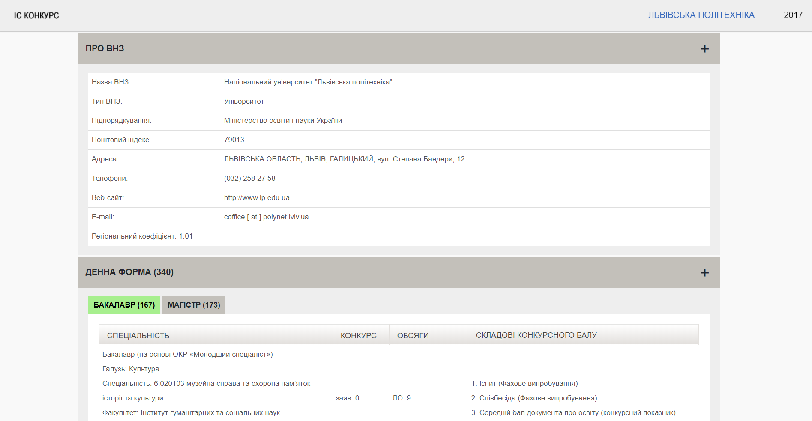
Vstup.info

Slide 10
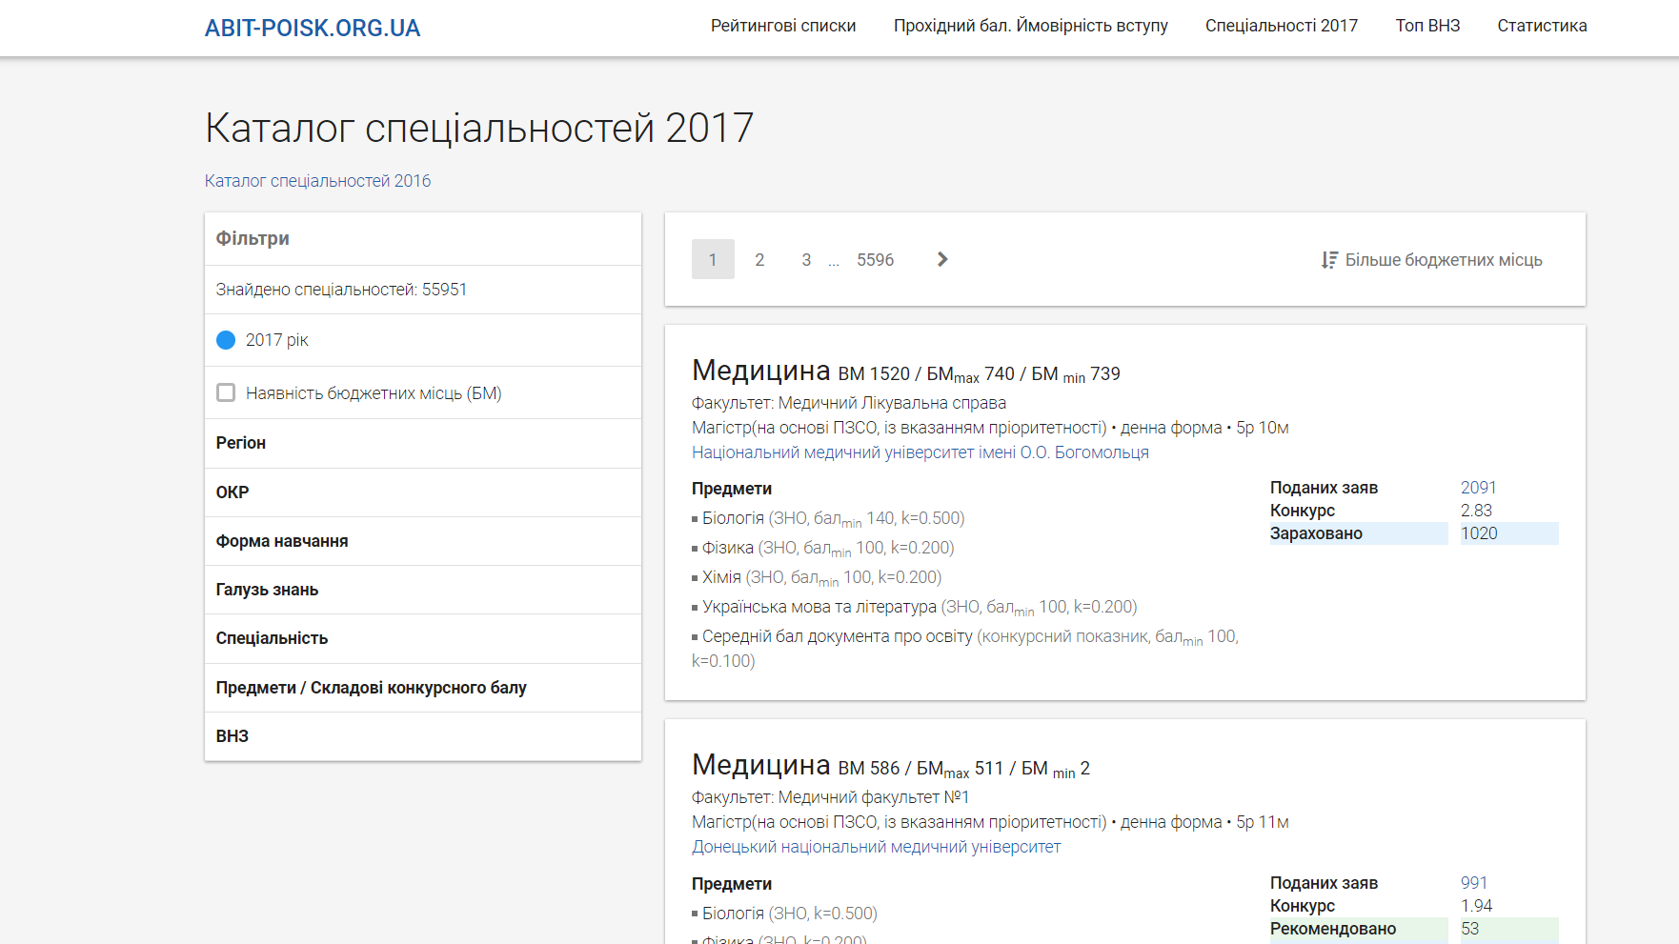
Abit-poisk.org.ua

Slide 11

















Technologies we use
SCRUM

Slide 12
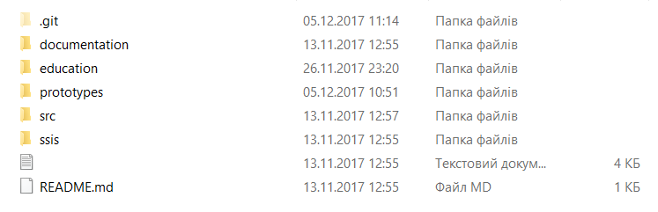
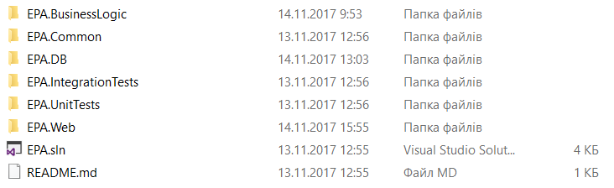
Solution architecture

Slide 13
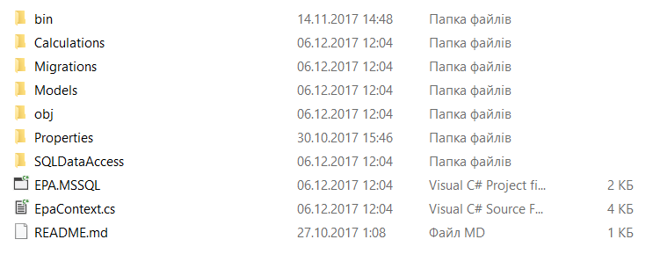
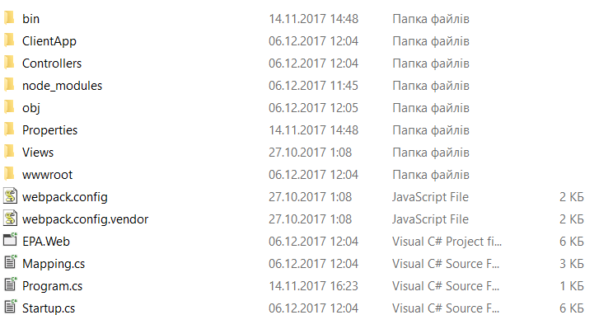
EpaDB
EpaWeb

Slide 14
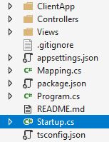
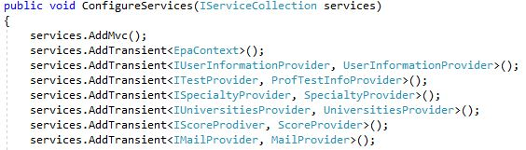
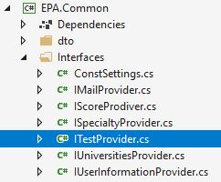
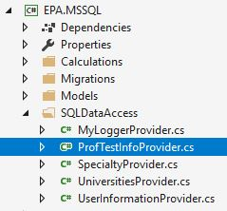
Anastasiya
Dependency injection

Slide 15
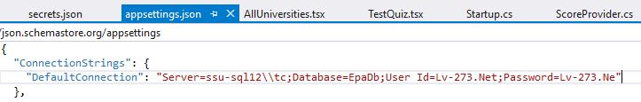
Anastasiya
User Secret Store
Solution?

Slide 16
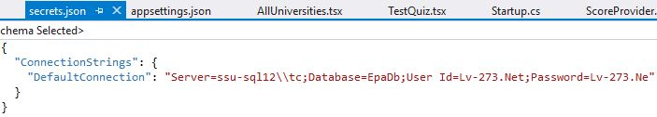
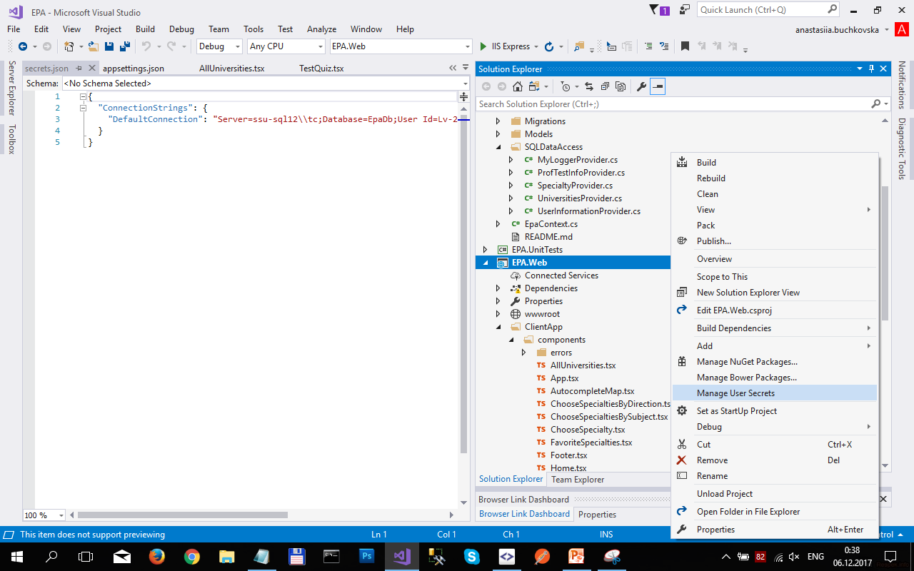
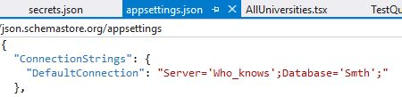
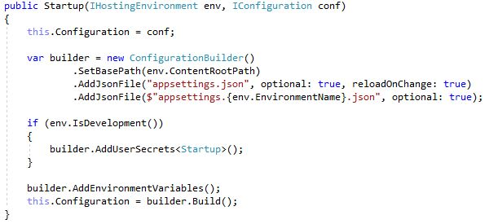
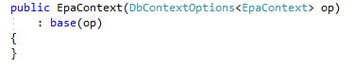
Anastasiya

Slide 17
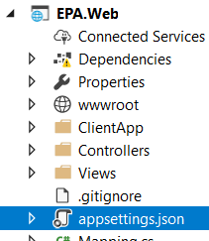
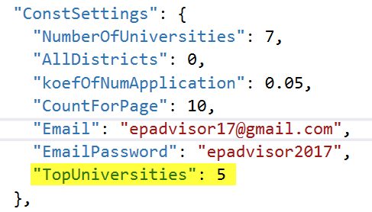
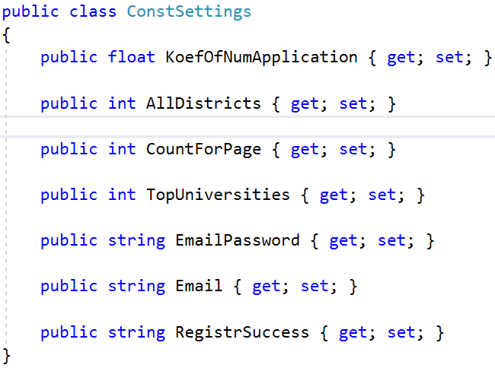
Nataliia
Configuration

Slide 18
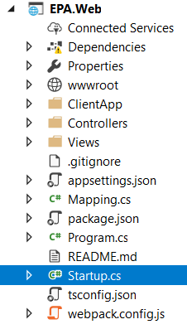
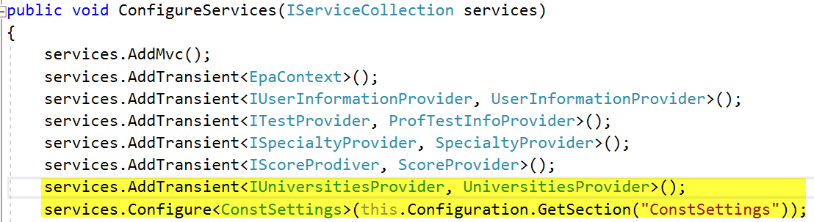
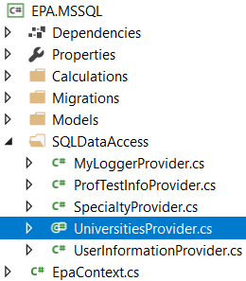
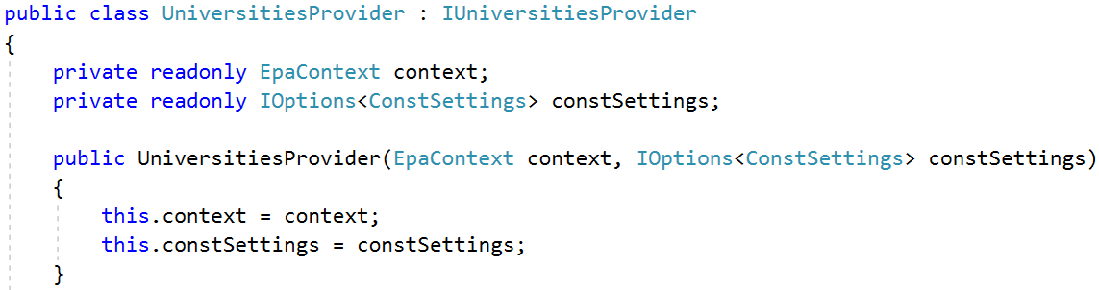
Nataliia
Configuration

Slide 19
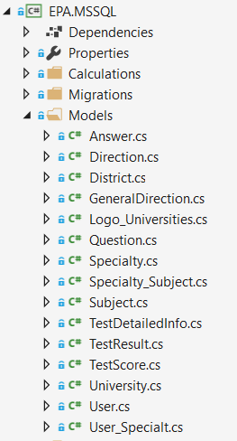
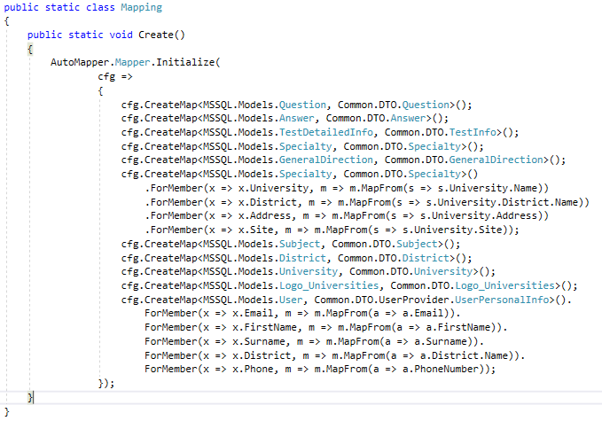
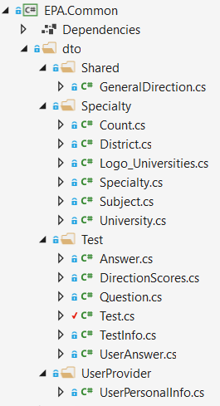
Anastasiya
DTO

Slide 20
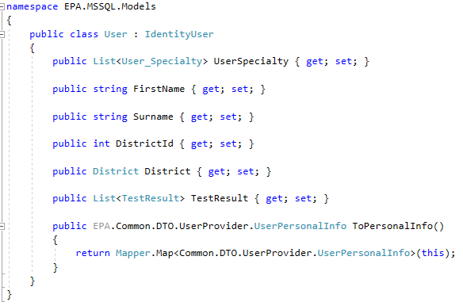
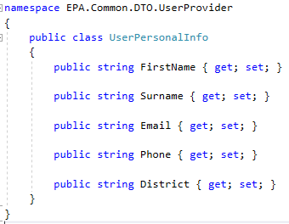
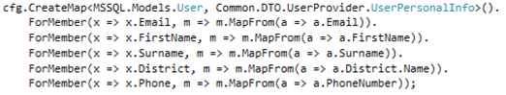
Anastasiya
DTO Example

Slide 21
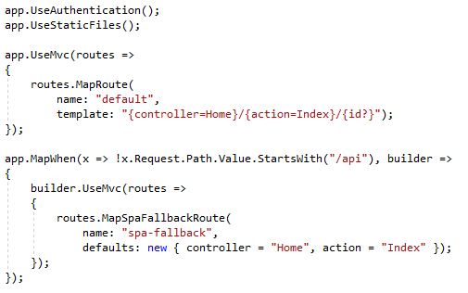
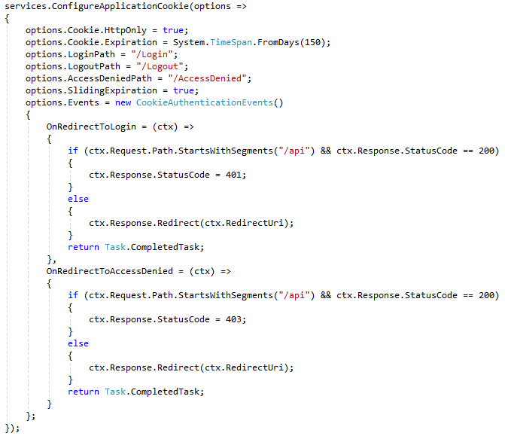
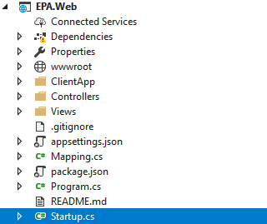
Vanya
Cookies & Routes in Startup.cs

Slide 22
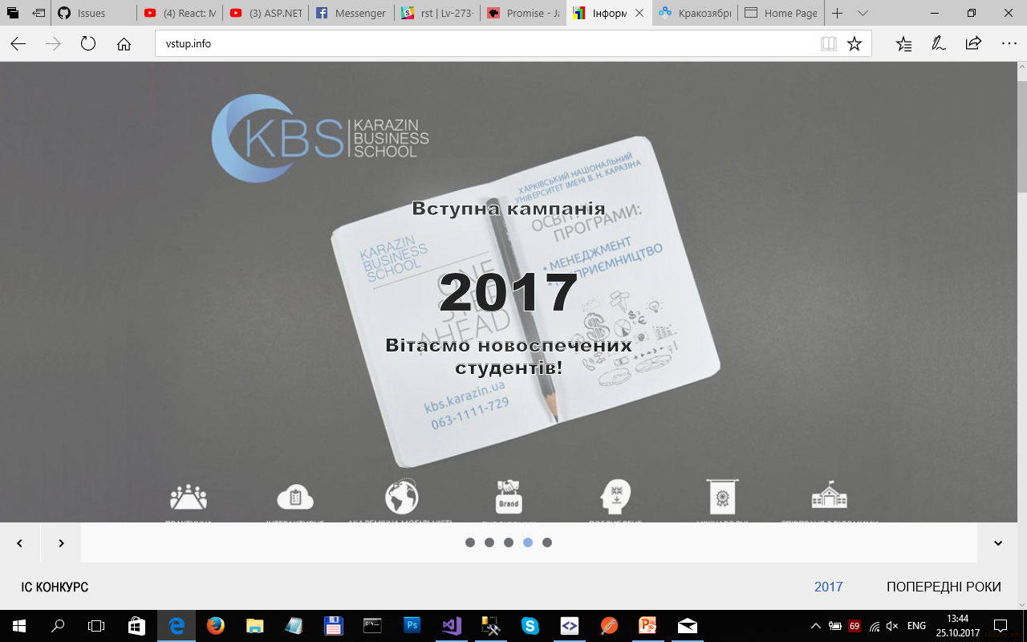

Andriy
Data integration
To fill data base tables that contain information about universities and their specialties, we created additional ETL service that parses information from site “vstup.info” and it will run periodically.
MSSQL

Slide 23
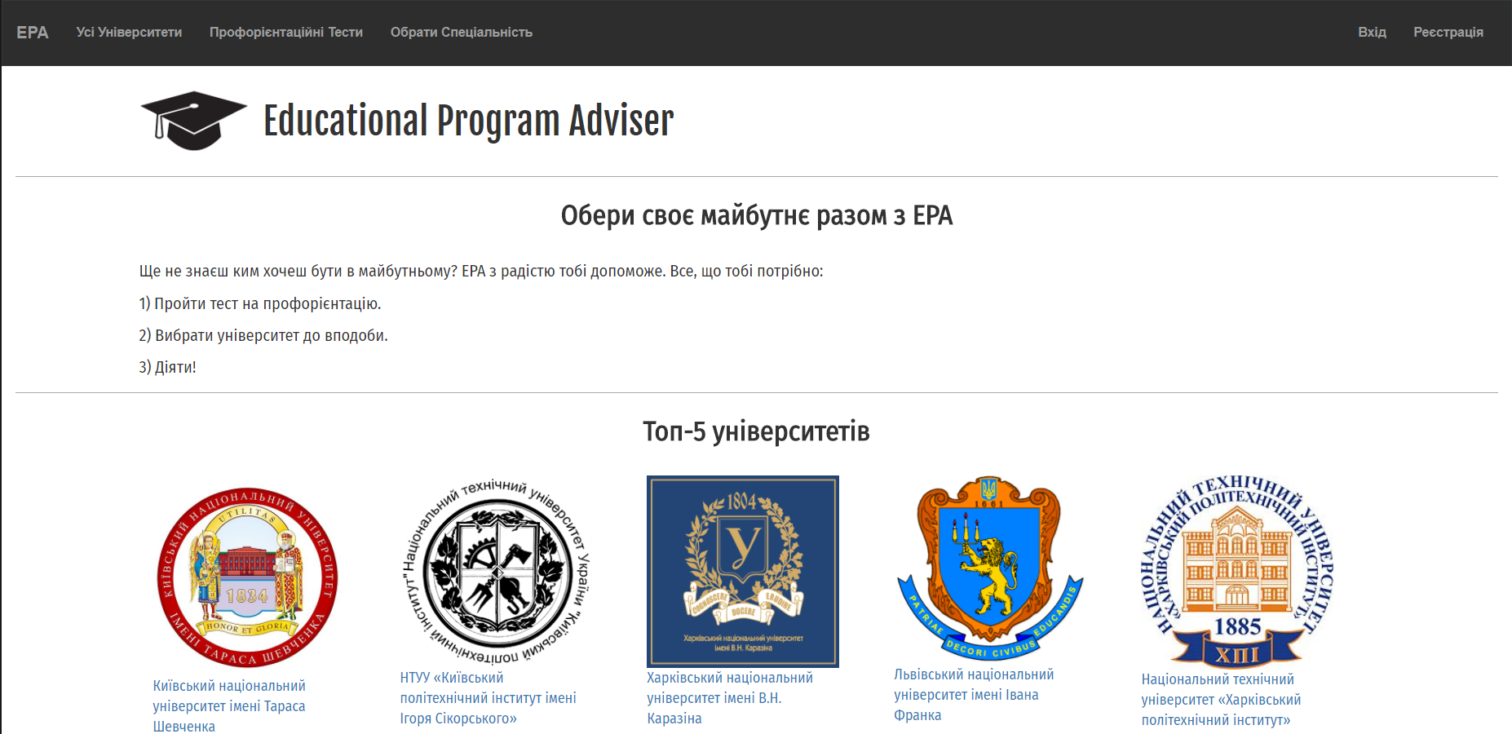
Nataliia
Home Page with 5 top universities

Slide 24
Nataliia
Top Universities
As a user I would like to see the top 5 universities on the start page:
in ETL download universities and information about them (including pictures);
create procedures for access on DB: GetTopUniversities(), GetLogoById(int id);
create methods on API;
create component on UI: Home.

Slide 25
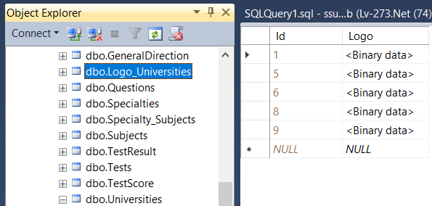
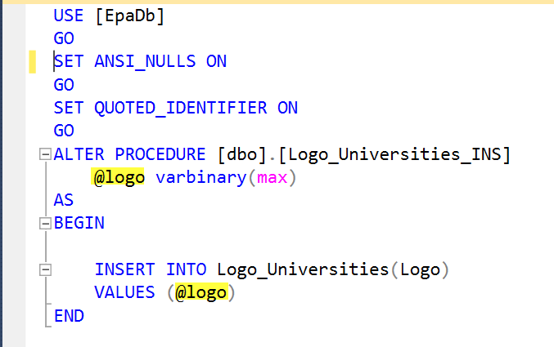
Nataliia
Table Logo_Universities and Stored Procedure in SQL Server 2014 Management Studio

Slide 26
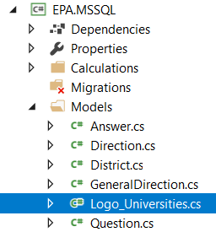
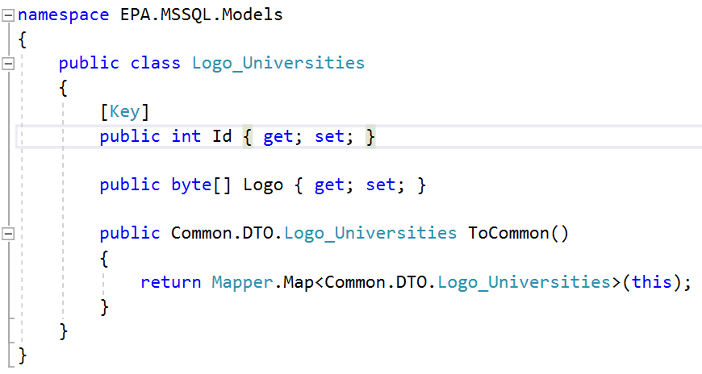
Nataliia
Logo_Universities Model

Slide 27
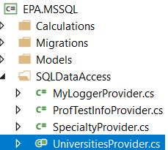
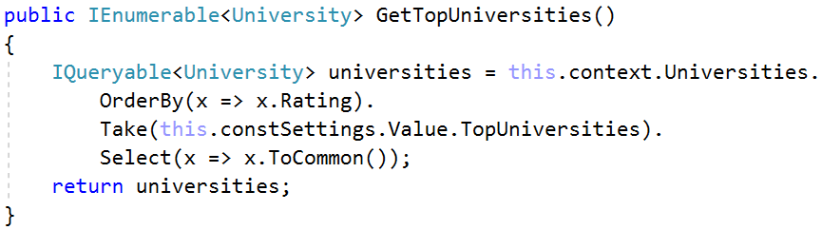
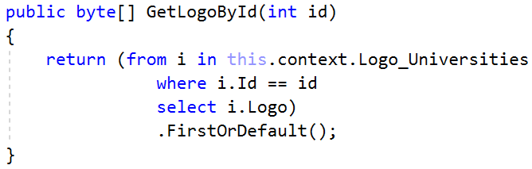
Nataliia
Universities Provider
S

Slide 28
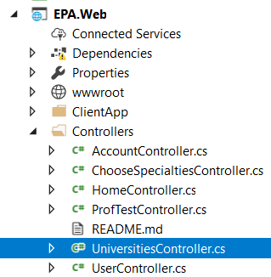
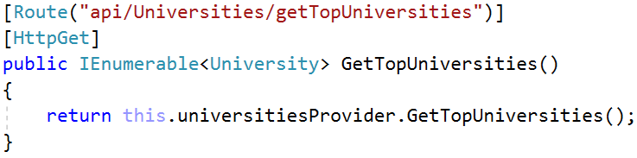
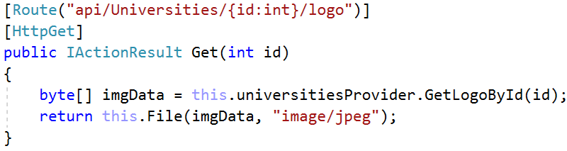
Nataliia
Universities Provider

Slide 29
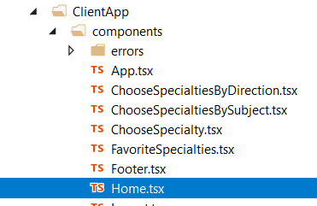
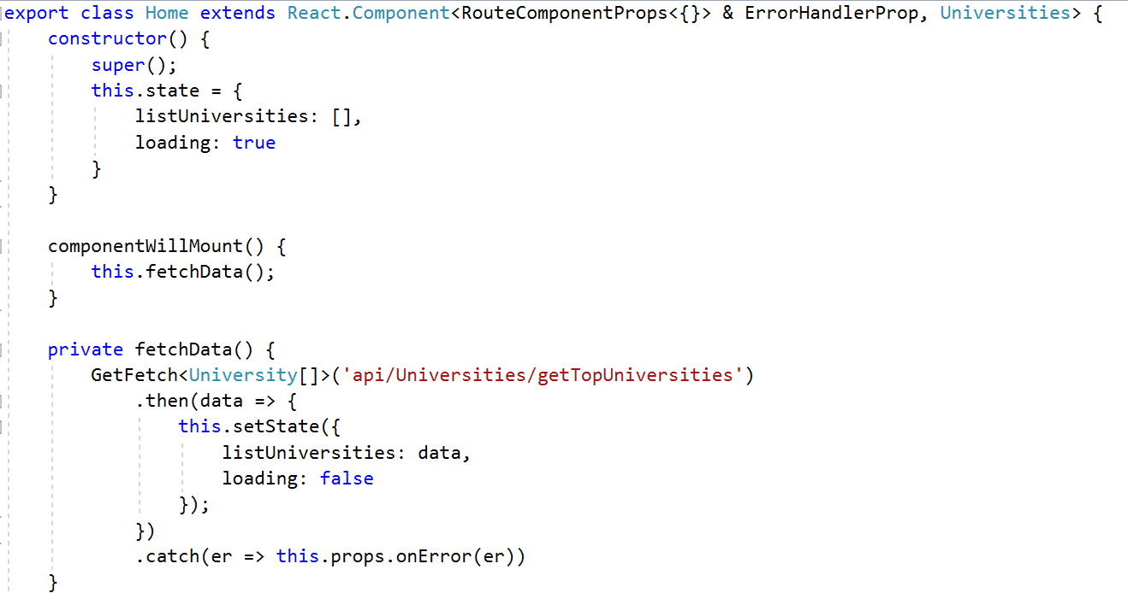
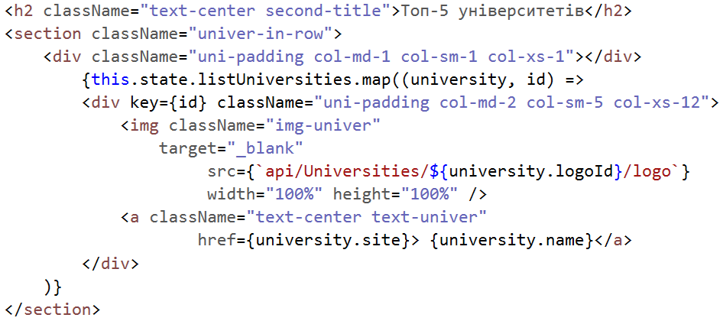
Nataliia
Home.tsx - Component of React

Slide 30
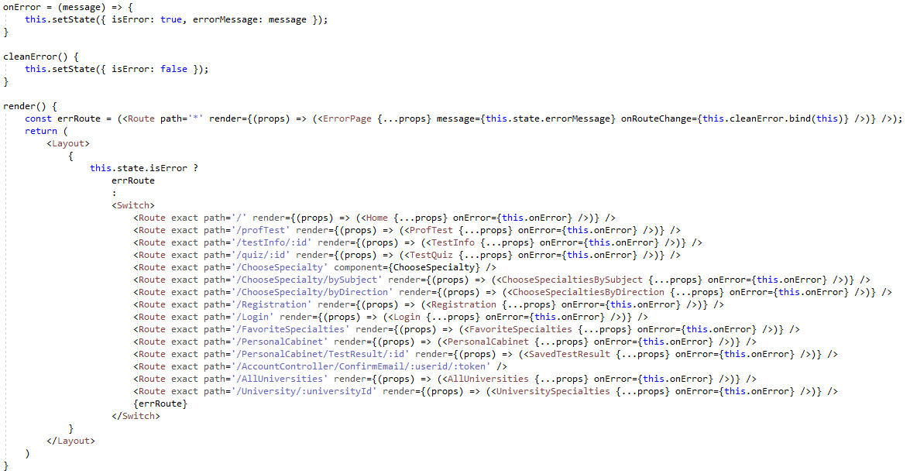
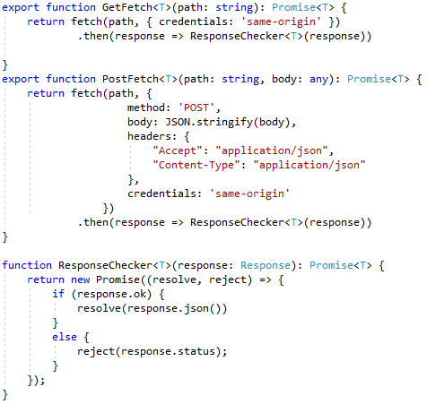
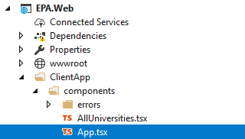
Vanya
App.tsx component

Slide 31



Vanya
Error.tsx component

Slide 32
Anastasiya
All Universities

Slide 33
Anastasiya
All universities
As a user I would like to view list of all universities in selected district
create method on DB that retrieves all universities in current district;
create methods on API;
create AllUniversities and UniversitySpecialties components on UI;

Slide 34



Iryna

Slide 35


Anastasiya
Method on DB that retrieves all universities in current district

Slide 36



Anastasiya
Method on API that retrieves all universities in current district

Slide 37


Anastasiya
React component for universities

Slide 38



Iryna
All Universities component

Slide 39

Anastasiya
Component on UI

Slide 40

Anastasiya
Component on UI

Slide 41


Anastasiya
Method on DB that retrieves specialties
of direction in university

Slide 42


Anastasiya
Method on API that retrieves all universities in current district

Slide 43


Anastasiya
React component for specialties

Slide 44
Anastasiya
Professional orientation test

Slide 45
Anastasiya
Professional orientation test
As a user I would like to pass professional orientation test and get result based on answers
create models to store
questions and answers
universities, specialties, directions and subjects;
create methods on DB to get questions and to get information about each direction;
create method on BL to calculate scores;
create methods on API;
create TestQuiz and Question components on UI;

Slide 46

Taras
Professional orientation test

Slide 47




Iryna
Test Information Model and DAL

Slide 48


Nataliia
Methods on API

Slide 49



Taras
Professional orientation test

Slide 50

Taras
Test detail component

Slide 51


Taras
Test Information React

Slide 52

Anastasiya
Component on UI

Slide 53


Anastasiya
Models to store questions and specialties

Slide 54


Anastasiya
Method on DB that returns a collection of questions for a specific test

Slide 55



Anastasiya
Method on API to get questions

Slide 56



Anastasiya
React component for questions

Slide 57


Anastasiya
Method on BL to calculate scores

Slide 58

Anastasiya
Method on DB that retrieves collection of all general directions from database

Slide 59



Anastasiya
Unit tests

Slide 60

Anastasiya
Get test result on API

Slide 61


Anastasiya
Get result on UI

Slide 62
Anastasiya
Component on UI

Slide 63


Iryna
Test Result page
………………

Slide 64

Taras
DB for Get Specialties

Slide 65



Iryna
Getting specialties by direction DAL

Slide 66


Vanya
Getting Authorized Specialties at MSSQL

Slide 67




Iryna
Rating Provider

Slide 68


Iryna
Getting specialties by direction API

Slide 69




Iryna
Test Result component

Slide 70

Iryna
Test Result component

Slide 71



Iryna
Test Result component

Slide 72
Iryna
Test Result page
………………

Slide 73

Vasya
Choose specialty by direction and district
As a user I would like to find specialty by direction in a concrete district
in ETL download specialties, universities and information about them;
create procedures for access on DB;
create methods on API: GetAllDistrict, GetSpecialtiesByDirection, GetGeneralDirection;
create component on UI

Slide 74


Nataliia

Slide 75



Nataliia

Slide 76


Nataliia
ListSpecialies

Slide 77

Nataliia

Slide 78



Andriy
Pagination

Slide 79

Andriy
Pagination

Slide 80
Vasya
Choose specialty by subjects and district
As a user I would like to find specialty by subjects in a concrete district
in ETL download specialties, universities and information about them;
create procedures for access on DB;
create methods on API: GetAllDistrict, GetSpecialtiesBySubjects, GetGeneralDirection;
create component on UI

Slide 81



Taras
Choose specialty by subjects DAL

Slide 82

Vasya
Choose specialty by subjects API

Slide 83



Vasya
Choose specialty by subjects REACT

Slide 84

Vasya

Slide 85

Andriy
Registration
As a user I would like to register, have my personal cabinet and save my favorite specialty there.

Slide 86



Andriy
Registration
…

Slide 87

Andriy
Registration

Slide 88


Andriy
Login

Slide 89

Anastasiya
Email

Slide 90


Anastasiya
Method on BL to send email

Slide 91


Anastasiya
Registration API

Slide 92

Anastasiya
Confirm email API

Slide 93

Andriy
Login

Slide 94

Iryna
Login API

Slide 95



Andriy
Login React

Slide 96

Andriy
Login React

Slide 97

Taras
Personal Cabinet

Slide 98


Vasya
Personal Cabinet DAL

Slide 99



Taras
Personal Cabinet API

Slide 100


Taras
Personal Cabinet React

Slide 101
Taras
Personal Cabinet - Change Password

Slide 102


Taras
Change Password

Slide 103


Taras
Change Password React

Slide 104

Taras
Personal Cabinet Tests Result

Slide 105

Vasya
DB models for Test Result

Slide 106


Vasya
Personal Cabinet add Tests Result

Slide 107


Vanya
Getting Saved Test Results DAL

Slide 108


Vanya
SavedTestResult.tsx component

Slide 109
Taras
Personal Cabinet – Favorite Specialties

Slide 110

Vasya
Favorite Specialties Models

Slide 111



Vasya
Favorite Specialties DAL

Slide 112

Vasya
Favorite Specialties DAL

Slide 113



Vanya
Favorites in ListSpecialties.tsx component

Slide 114



Taras
Favorite Specialties React

Slide 115

Taras
Favorite Specialties Page

Slide 116


